Slide 1
Class 1: What is AI?
Principles of ML & Deep Learning - SAILea
Anisha Raghu and Ananya Raghu

Slide 2
Icebreakers
Name
Grade
A fun fact about yourself :)
How much do you know about AI? (it’s ok if you do not have much past experience)

Slide 3
Machine Learning Models
Decision Trees
Random Forest
Linear & Logistic Regression
K-nearest neighbors
Etc…

Slide 4
What is AI?
Based on patterns
Process large amounts of data and make predictions from it
Traditional programming: does step by step commands - like a recipe using ingredients
AI: Give computer various ingredients, and various outputs, and have it build or learn the recipe

Slide 5
Supervised, Unsupervised Learning, Reinforcement
In simple terms, supervised learning is the process of using labeled examples to predict unlabeled examples
Unsupervised learning: uses unlabeled data, discovers “structure” or underlying patterns in data
Machine Learning: Process of learning to pick actions based on rewards and punishments from previous choices

Slide 6
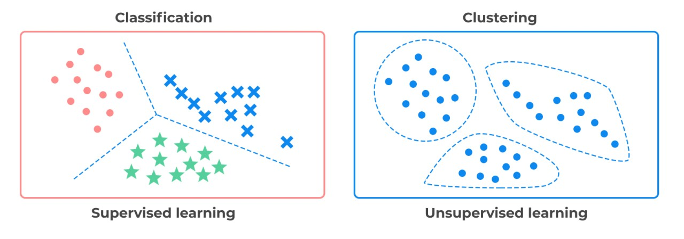
Notes:
https://www.google.com/url?sa=i&url=https%3A%2F%2Fwww.linkedin.com%2Fpulse%2Fsupervised-vs-unsupervised-learning-whats-difference-smriti-saini&psig=AOvVaw1MemC1Mykcq0fNW7xHHpwK&ust=1696207990949000&source=images&cd=vfe&opi=89978449&ved=0CBAQjRxqFwoTCND2mKjR04EDFQAAAAAdAAAAABAJ

Slide 7
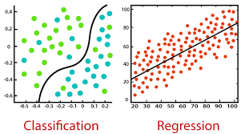
Regression vs Classification
Regression helps predict CONTINUOUS values
Classification simply classifies or predicts DISCRETE class labels
Source: https://www.javatpoint.com/regression-vs-classification-in-machine-learning
Practice question: I want to predict the temperature tomorrow in San Francisco. Would this be a classification or regression problem? What if I wanted to ask if it will rain or be sunny (assuming these are the only possible scenarios)?

Slide 8
Data
While implementing machine learning, we generally split our data into three sets:
1) Training Data - data used to fit the model
2) Validation Data - Used to evaluate model performance at each step (epoch) of training. Note: model “sees” this, but does not “learn” directly from this
Example: I am designing a model - I would use validation dataset to decide hyperparameters of the model → for example, how many layers should be included?
3) Testing Data - Used after training has completed to observe final performance of model

Slide 9
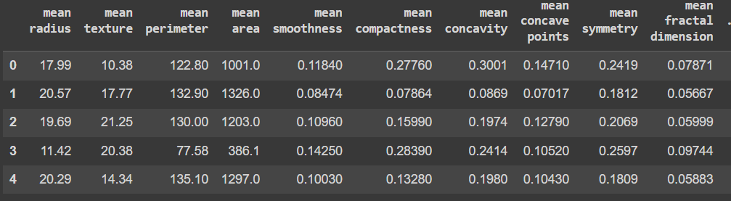
Example Dataset for ML
Each row can be thought of as a point in n-dimensional space, where n is the number of features!

Slide 10
Metrics
After training our model, how can we evaluate its performance?
Basic metric: accuracy
(number of correct decisions)/total decisions

Slide 11
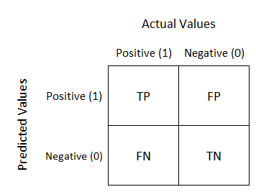
Continued - Confusion Matrices
Way to visualize the performance of an algorithm
Summarizes performance of a classification algorithm
Source of Image: https://towardsdatascience.com/understanding-confusion-matrix-a9ad42dcfd62

Slide 12
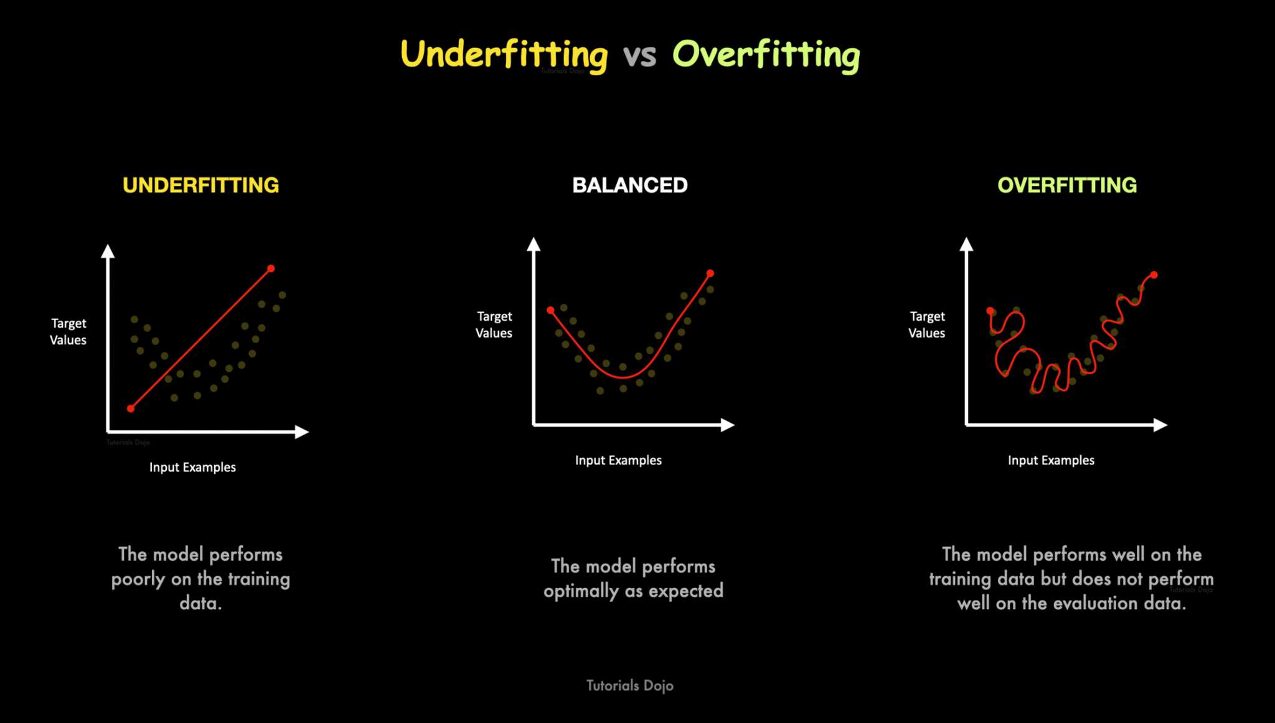
Overfitting versus Underfitting
Source: https://www.linkedin.com/pulse/underfitting-vs-overfitting-simplified-jon-bonso

Slide 13
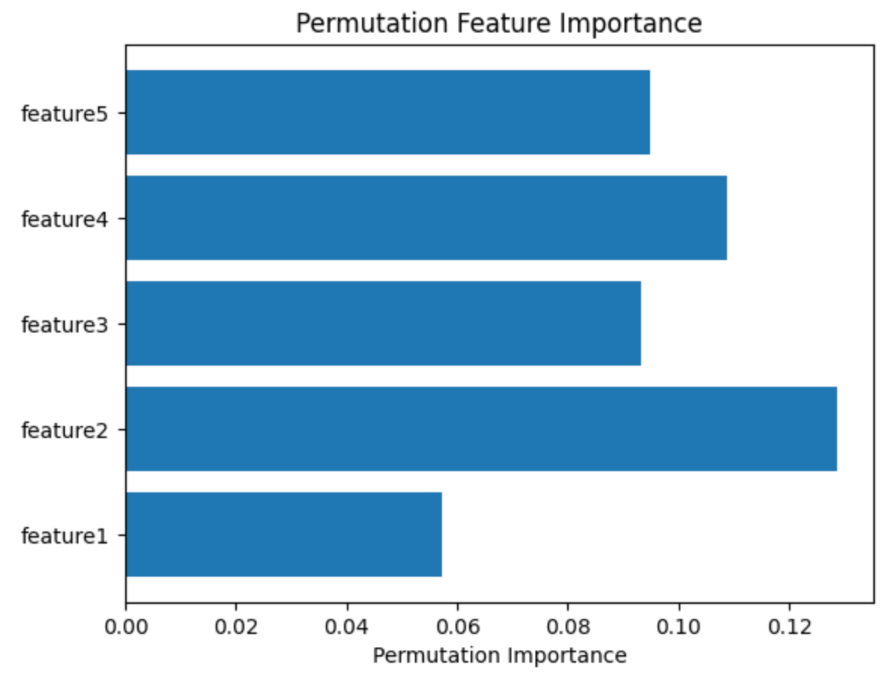
Feature Importance
Indicates how much each feature contributes to the overall prediction
Permutation Feature Importance: Permute one feature in the dataset and see how it affects the prediction.
Source:https://towardsdatascience.com/feature-importance-in-machine-learning-explained-443e35b1b284

Slide 14
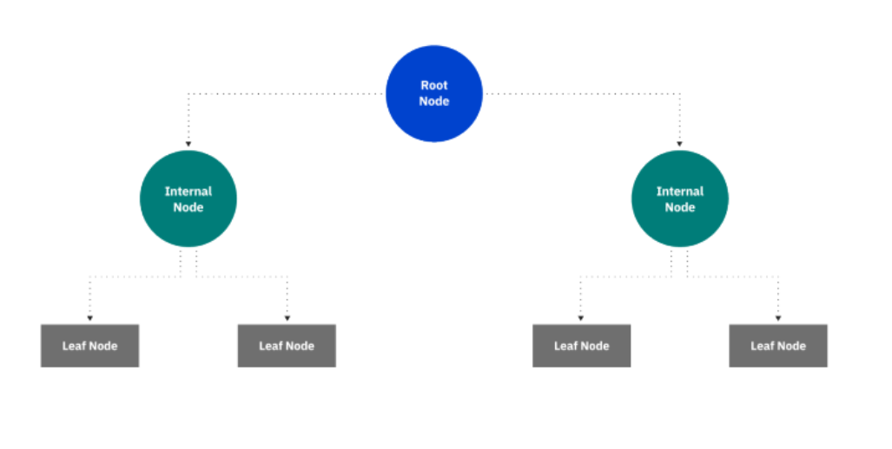
Decision Tree
A decision tree is a supervised learning algorithm
Used for both classification and regression tasks.
Tree structure, which consists of a root node, branches, internal nodes and leaf nodes.

Slide 15
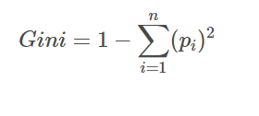
Decision Tree Explained
How does a decision tree decide what is the condition at each node?
A commonly used method is via the gini calculation, which measures “impurity” in a distribution:
Where p_{i} is the probability of an object
being classified to a particular class

Slide 16
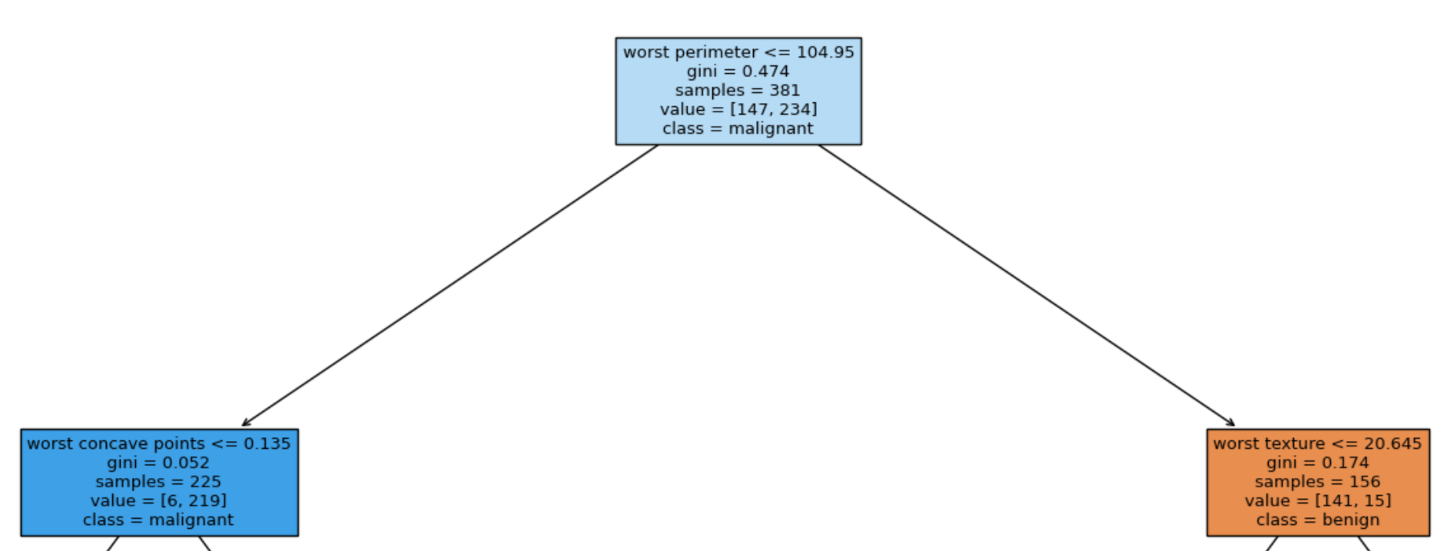
Example: Gini Calculation
In the second layer, the gini value for the blue box is 0.052 because it is 1 - (6/225)^2 - (219/225)^2. This can be thought of as a collection of 6 blue marbles, 219 red marbles, which is close to being very pure.

Slide 17
How do Decision Trees use the Gini Index?
First, the decision tree will choose a split function.
Based on split function, finds probability of going to left node or going to right node (P_{R} , P_{L})
Then, can compute gini for left node and gini for right node
The decision will try to pick the split function that minimizes P_{L}*Gini_{L} + P_{R}*Gini_{R}

Slide 18
Any questions?

